Slide 1
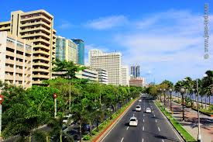
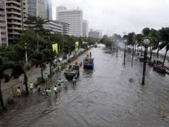
Spot the diference!
Social plugins
1. Flooded streets
2. Less trees
3. More buildings
4. Smog
Location: Roxas Boulevard, Pasay City

Slide 2
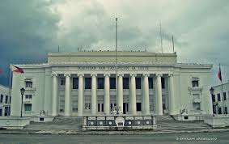
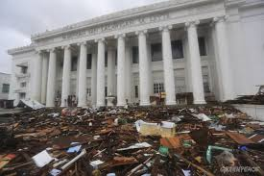
Spot the diference!
Social plugins
1. Mud and debris
2. Missing flagpoles
Location: City Hall of Leyte

Slide 3
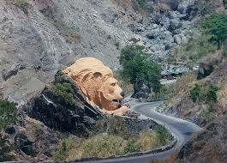
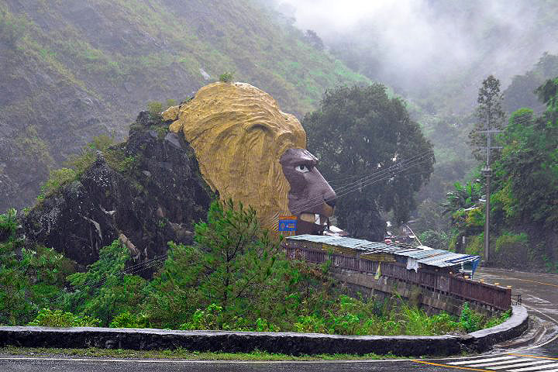
Spot the diference!
Social plugins
1.Trees and shrubs on the hills
2.Informal settlers
3.Road side barricades
4.
Location:

Slide 4
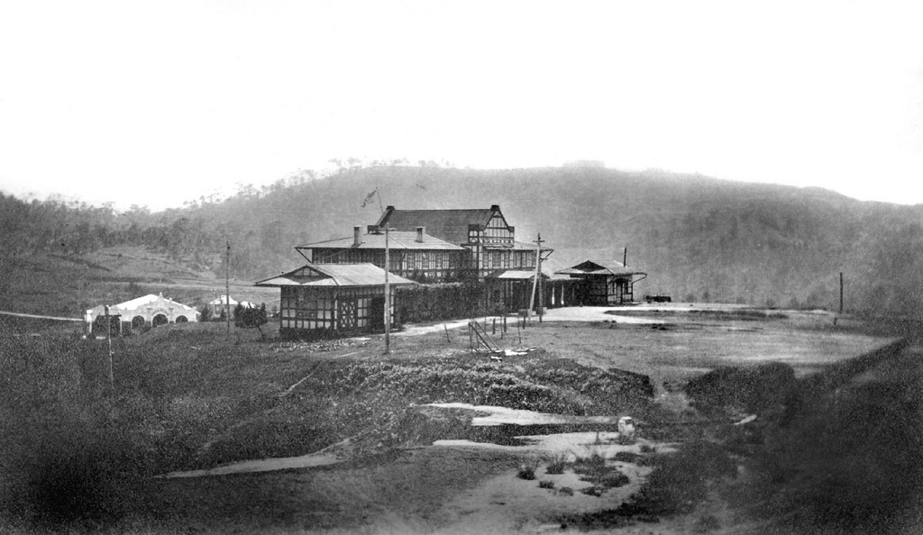
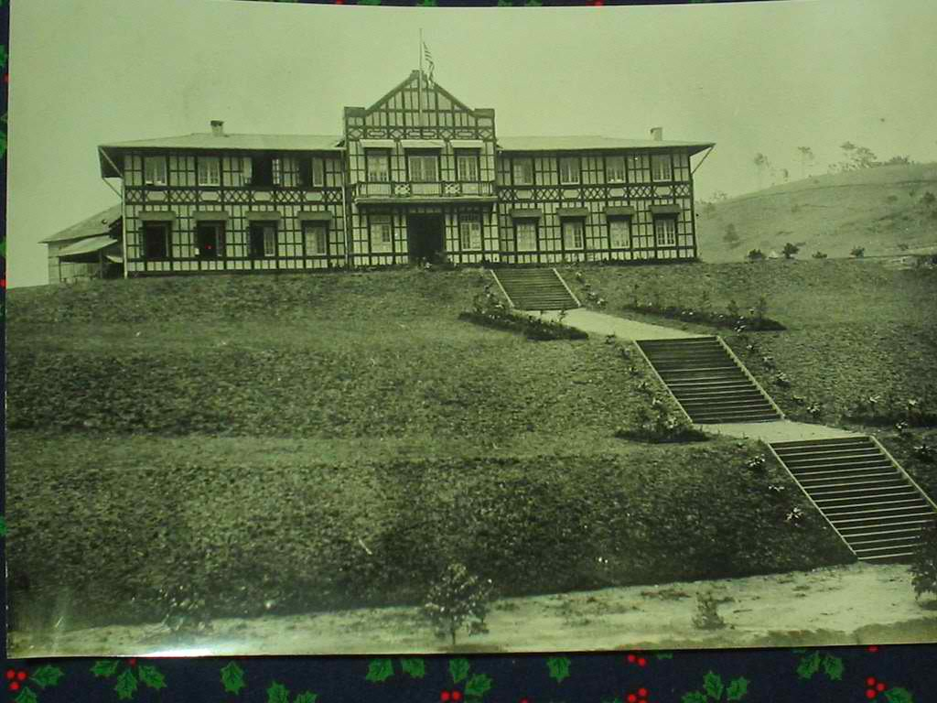
Spot the diference!
Social plugins
1. Elevation/slopes
2. Flattened hills
3. Stairs
Location: City Hall, Baguio

Slide 5
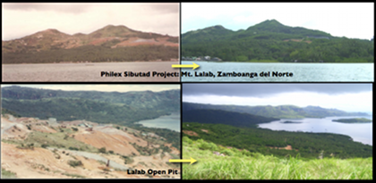
Spot the diference!
Social plugins
1. Denuded forest/mountain
2. Mining/open pit
3. Polluted ocean
Location: Sibutad, Zamboanga del Norte

Slide 6
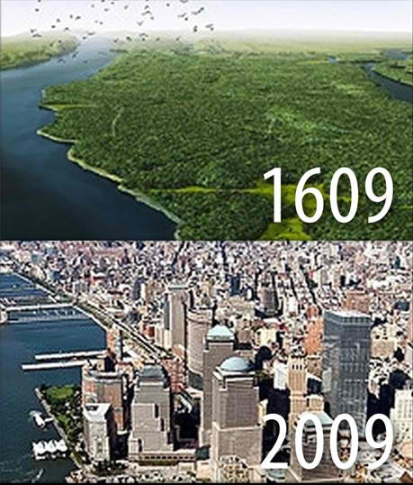


Got some thoughts?
Social plugins
Location: Manhattan, USA

Slide 7
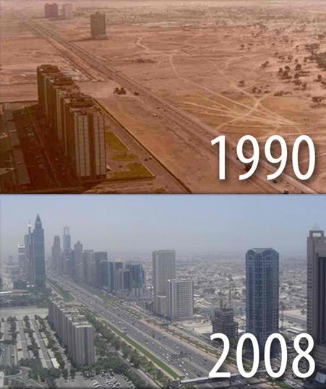
Got some thoughts?
Social plugins
Location: Dubai

Slide 8
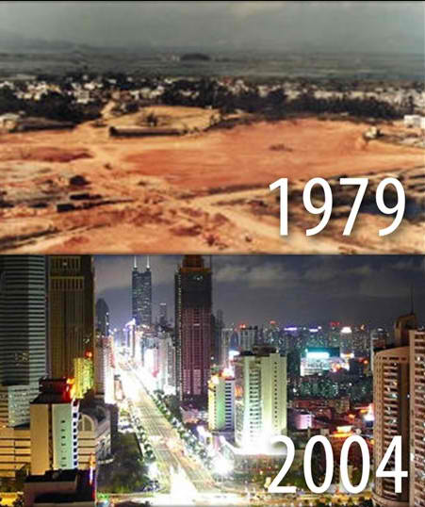
Got some thoughts?
Social plugins
Location: Shenshen, China

Slide 9
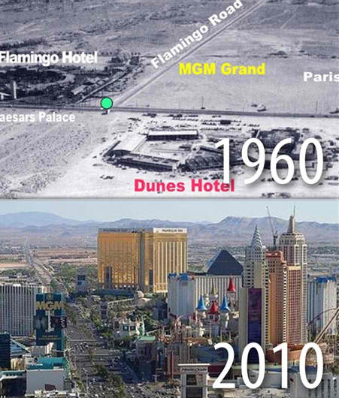
Got some thoughts?
Social plugins
Location: Las Vegas, USA

Slide 10
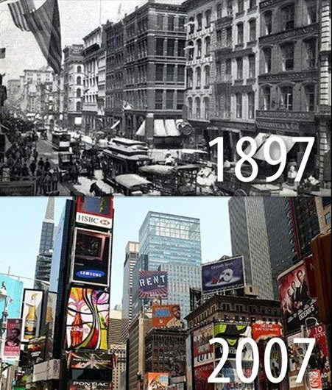
Got some thoughts?
Social plugins
Location: Times square, New York

Slide 11
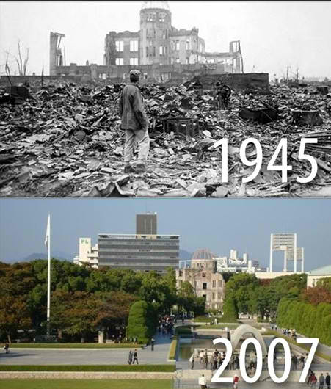
Got some thoughts?
Social plugins
Location: Hiroshima, Japan

Slide 12
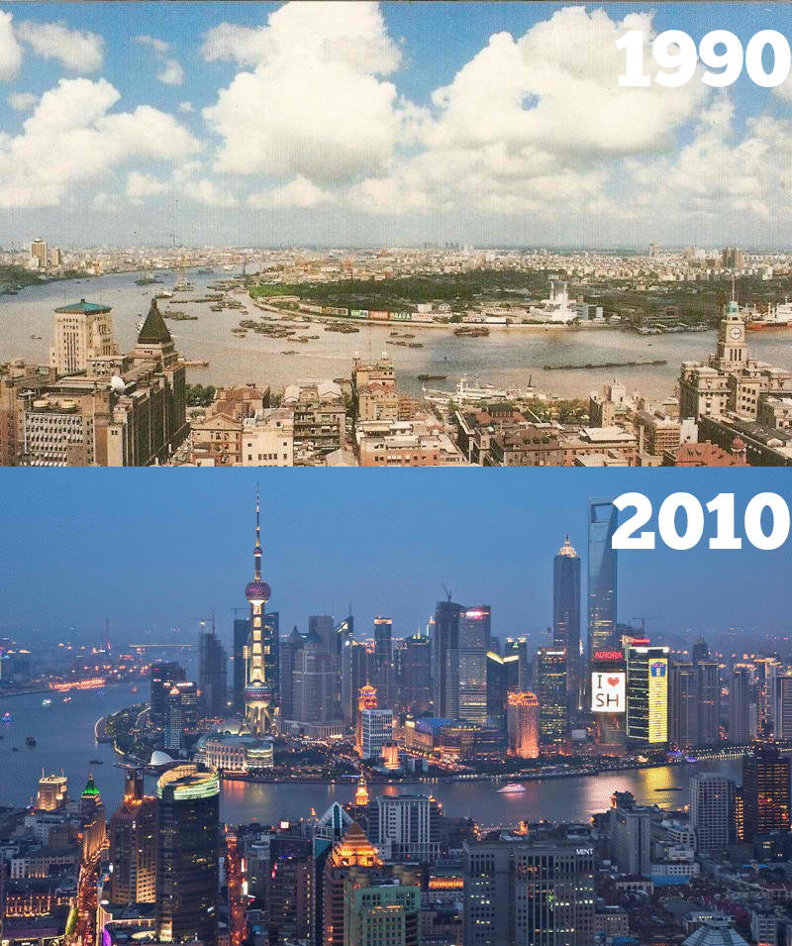
Got some thoughts?
Social plugins
Location: Shaghai, China

Slide 13


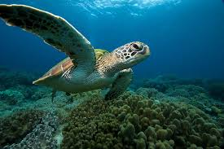
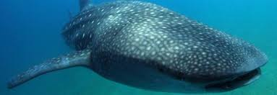
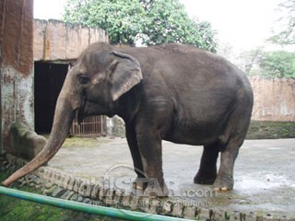

SAGIP CAMPAIGN
QR Code
Map of the philippines
Mechanics: Look for the QR codes in the designated locations where these endangered flora and fauna are found. Evaluate their conditions and help save these species from extinction. Join the SAGIP CAMPAIGN!

